Slide 1
Programming Concepts-IV
Chapter 5

Slide 2
Introduction
We all know that the processor we use is connected to the I/O as well as the memory
So far, we have only discussed with data being read from and written to memory
Even though we have used the I/O devices like the keyboard and monitor, but for these we used DOS interrupts, which are functions already written
Lets try for interacting the I/O directly using the instructions of 8086
In practice, I/O devices are not connected directly to the processor but are connected through interfacing chips which provides control signals for the processor to communicate with the peripheral.

Slide 3
Input/ Output Programming
There are many I/O devices connected to the processor, using which data is taken in (input device) or data is given out (output device)
For I/O processing, there appears the concept of a ‘Port’, which means a register or storage area for data, from/to which the data is transferred to the processor
An I/O device is frequently referred to as a ‘port’ with an associated address.
Any I/O device has a unique address, known as ‘port address’ or simply mentioned as ‘port.

Slide 4
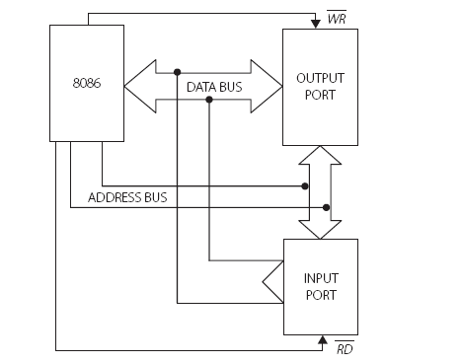
I/O ports with address bus and data bus and the read and write control signals

Slide 5
Figure shows an input and output device connected tot he processor through the address and data bus & a control pin.
When its address is placed on the address bus and the WR signal is activated, data from the processor is written to the output port
Similarly, data from the input port is read into the processor when the input port is addressed and the RD signal is activated

Slide 6
There are two schemes for connecting an I/O device to the processor
Memory Mapped I/O :
In this scheme, the I/O device has the same address space and addressing scheme as memory.
For example, given the instruction MOV AL, [3456H], the address 3456H may be a memory location or the address of an I/O device.
So I/O addressing does not need any special instructions.
Peripheral or Isolated I/O:
Also referred to as ‘I/O mapped I/O’ .
Here, there are special instructions catering to input and output devices
The address space is disjoint and separate from the memory address space. (Detail in Chapter 7)

Slide 7
I/O Instructions
8086 has two instructions to communicate:
IN :
usage: IN accumulator, port
This is the case when data is taken from the I/O device
It implies the device is an input device
using this instruction, an I/O read machine cycle is initiated and the data in the input device is transferred to the accumulator of the processor
OUT :
usage: OUT port, accumulator
here the data is given to an output device from the accumulator with the initiation of an I/O write machine cycle

Slide 8
Things to remember
In both cases, ‘port’ implies the port address, i.e the address of the I/O device
The source has always to be the ‘Accumulator’
Means the AL register if an 8-bit data is being transferred of AX register if a 16-bit register is used
No other register may be used
I/O addresses are limited to a maximum bit size of 16 bits.
Hence, there can be a maximum of 2 ports
Thus, there can be 2 input and 2 output ports, as the instruction used for input and output is different.
16
16
16

Slide 9
Two Formats for I/O Instructions
1. Fixed Port Addressing :
This is used only when the address of an I/O device is 8 bits wide
Here the address of the port is directly mentioned in the instruction.
Note that data can be 8 bits or 16 bits, depending on
the data bus width of the I/O device.
Example:
IN AL, 45H ;move 8-bit data into AL from an input port with address 45H
IN AX, 12H ;
OUT 34H, AL ; move 8-bit data from AL to an output port with address 34H
OUT 0FCH, AX ;

Slide 10
2. Variable Port Addressing:
This is used when the addressed port has a 16-bit address.
Here, the port address is to be loaded into DX and then only the I/O instruction can be used.
Only the DX register can be used for this.
Examples
Mov DX, 9876H ; load the address of the port in DX
IN AL, DX ; move 8-bit data into AL from an input port whose address is in DX
Mov DX, 0FC6H
OUT DX, AX

Slide 11
Consider an Example:
An 8086 is connected to two ports with 8-bit addresses. The address of the input port is 67H and the address of the output port is FEH. The input port sends a 16-bit data to the processor. Only the lower 12 bits are to be transferred to the output port. Write the relevant program lines for this.

Slide 12
Solution
IN AX, 67H
AND AX, 0FFFH
OUT 0FEH, AX

Slide 13
Modular Programming
Suppose to handle large programming problem
Its better to think of breaking it up into modules
then testing the individual modules separately
later they can be integrated to obtain a complete product.
Its useful to access some written modules to incorporate in new program
It also helps for various team work on different modules
All these indicate the importance of what we would term as “ Modular Programming”
In assembly programming the module concept can be used to write bigger assembly
Here different assembly files are tested individually and have to be linked together

Slide 14
There are many issues to be resolved for successful linking and execution:
i. The different modules that constitute the solution may be in different code segments.
ii. The data which is to be used by one module may have to be accessed by many different modules and the ‘permission’ for this must be indicated.
iii. Some labels used in a module may not be found therein. In that case, there must be some indication that these are defined in some other module to which linking is possible and will be done.
MASM has certain directives which are used in our program in order to resolve these issues

Slide 15
1. The Directive PUBLIC
When a data item or a procedure is to be allowed to be accessed by other modules, it is declared as PUBLIC .
Examples:
PUBLIC num1, num2, num3
This may also be declared as
PUBLIC num1
PUBLIC num2
PUBLIC num3
A procedure named MULT can be allowed access from other modules if it is declared as
PUBLIC mult

Slide 16
2. The Directive EXTRN
When a module needs to use data and code which have been defined elsewhere, it should use the directive EXTRN meaning that the labels being used in this module are external to the module.
Format
EXTRN name1
EXTRN name1:type, name2:type
Examples
EXTRN num1:byte
EXTRN num2:word,num3 : word
EXTRN multi :far ;a far procedure is declared

Slide 17
Running two modules moda.asm and modb.asm

Slide 18
Contd..

Slide 19
Assembling the two modules
The modules can be assembled and linked together using ml.exe.
The command is ml filename1.asm fi lename2.asm filename3.asm …
To see the output of the program
ml moda.asm modb.asm

Slide 22
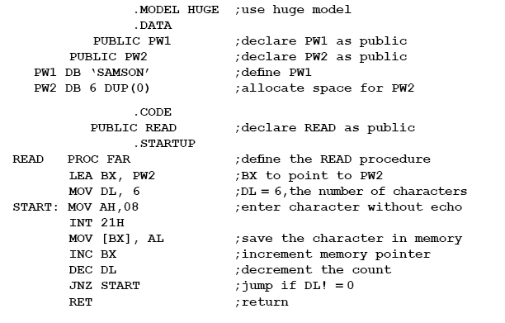

Slide 23
Programming in C with Assembly Modules
C is a very popular language ,while assembly programming is very efficient .
Combining the two gives a lot of advantages.
Here we discuss inline programming where assembly modules are inserted into C programs
The Borland C++ compiler has been used here.
There may be minor differences when using other C compilers

Slide 24
Example 5.7a
In this program ,the assembly module simply gets a character from the keyboard with echo.
It then uses carriage return and newline characters to go to the next line.
In the next line, the character entered is displayed.
Thus, the same character is displayed on two consecutive lines.

Slide 25
